Slide 1
Bank Marketing Campaign Analysis

Slide 2
Table Of Content
Introduction
Dataset
Database Creation, Data Cleaning And Inserting Data
Process Workflow
Imbalance Data (SMOTE)
ML Models and Results
Dashboard Walkthrough and Recommendations
Conclusion

Slide 3
Introduction
A Portuguese Bank has launched its marketing campaign trying to increase the number of subscribers for their term deposits.
Analyzing the marketing campaign results using several ML techniques to predict if the customer will subscribe for the term deposits.
Using dashboard to identify insights and provide recommendations on targeting specific group of people.

Slide 4
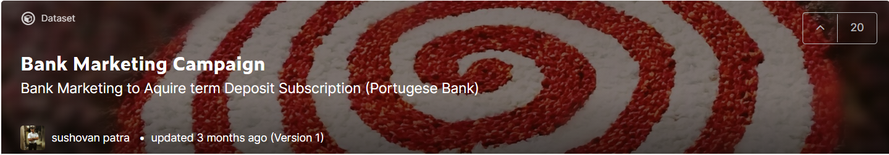
Dataset
Data Source : https://www.kaggle.com/edith2021/bank-marketing-campaign

Slide 5
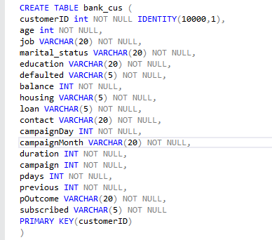
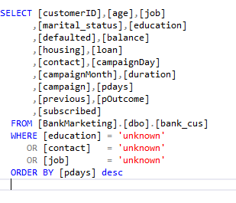
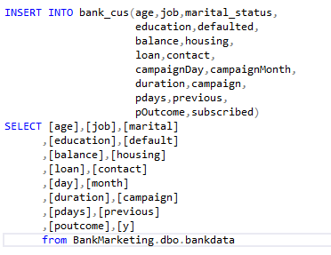
Database Creation, Data Cleaning And Inserting Data

Slide 6
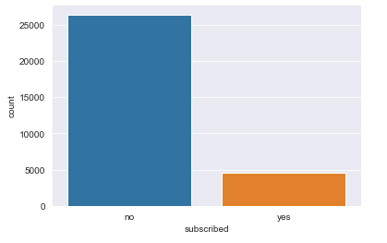
Imbalanced Data And Using SMOTE
A huge difference between the number of subscribers and non-subscribers, resulting in imbalanced data
Using SMOTE to create synthetic data from minority class

Slide 7
ML Models and Results
Various ML Models Implemented
Logistic Regression
Random Forest
Decision Tree

Slide 8
ML Models Results
Model | Training Accuracy | Testing Accuracy | Precision | Recall | F1 Score
Random Forest | 0.890499 | 0.861737 | 0.864520 | 0.861926 | 0.861514
Decision Tree | 0.878564 | 0.841704 | 0.843120 | 0.841843 | 0.841576
Logistic Regression | 0.827413 | 0.827875 | 0.829211 | 0.828013 | 0.827739

Slide 9
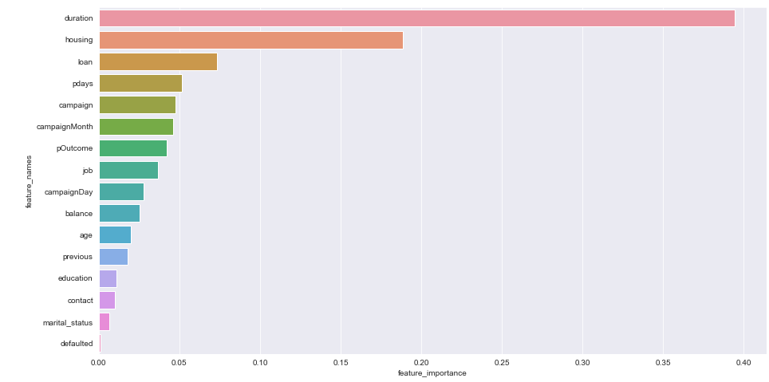
ML Model – Feature Importance

Slide 10
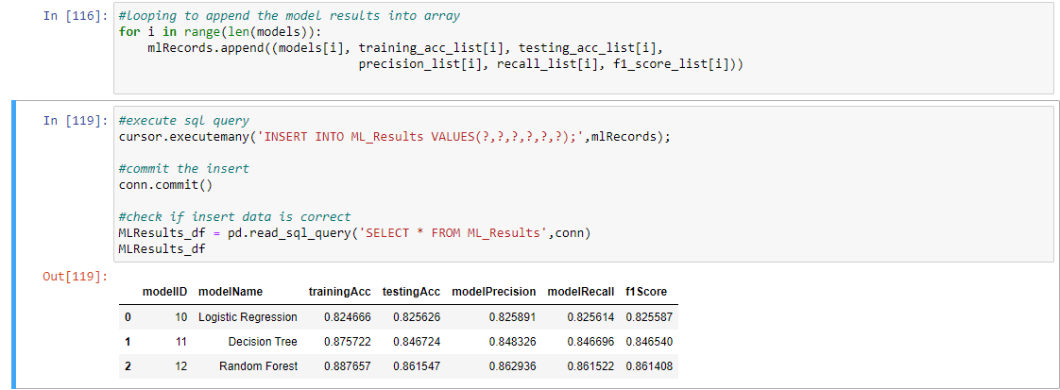
Storing/Retrieving ML Model Results

Slide 11
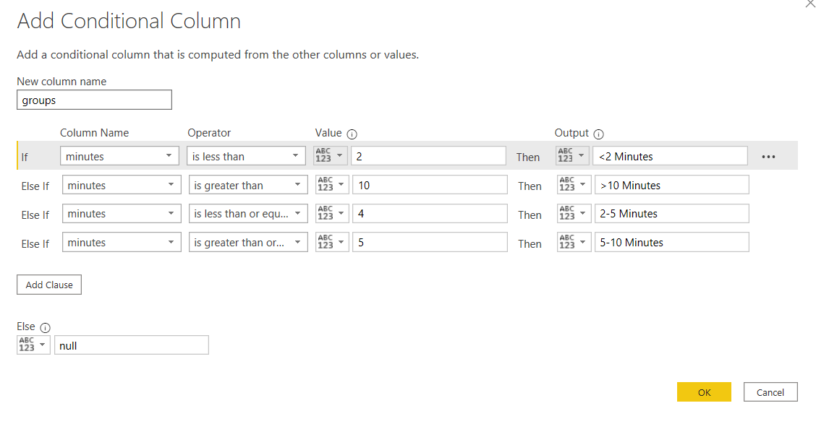
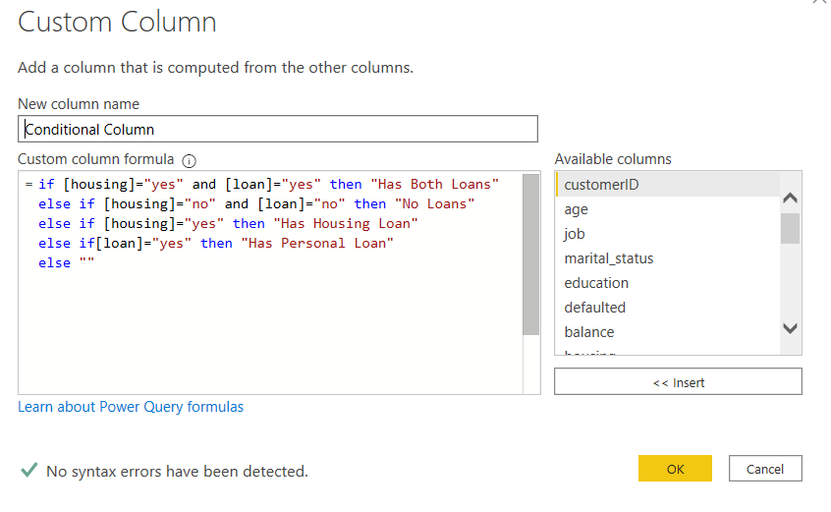
Dashboard Data Transformation
Creating Additional Column
Creating Custom Column

Slide 12
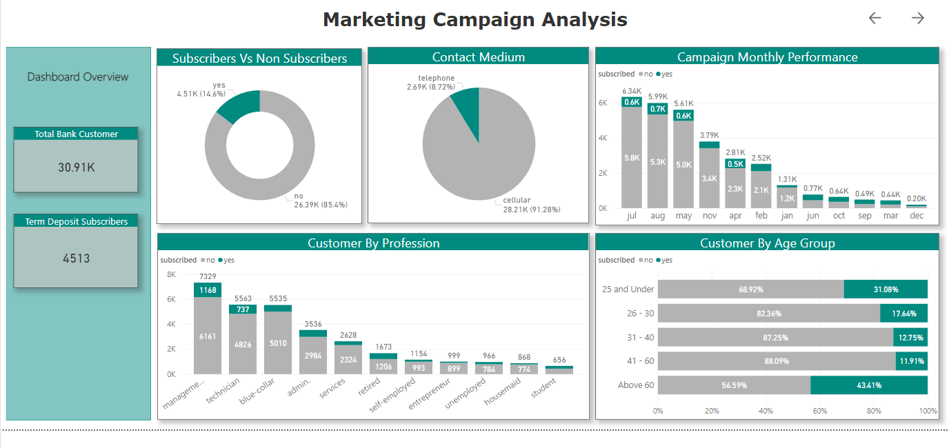
Dashboard Walkthrough/Recommendations

Slide 13
Conclusion
Based on the PowerBI Dashboard Analysis, it is recommended that the sales team to target the following sector:
The top 5 profession which accounts >70% of the subscribers
Customers with no loans are more likely to subscribe
Try to make the calls more interesting, to have a better chance of customers subscribing

